Slide 1



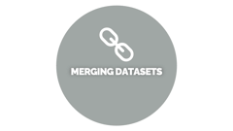


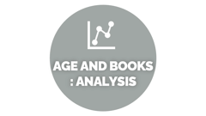


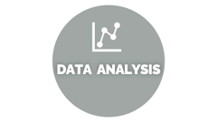







BOOK RECOMMENDATION SYSTEM

Slide 2










BOOK RECOMMENDATION SYSTEM
PRESENTED BY GROUP 4 :
PRAVEEN
SHRUTI
SHWETA
ABHINAV
AKSHAY
HRUSHIKESH
MAYURI
TEJAS

Slide 3


BUSINESS PROBLEM

Slide 4



BUSINESS PROBLEM
During the last few decades, with the rise of YouTube, Amazon, Netflix, and many other such web services, recommender systems have taken more and more place in our lives. From e-commerce (suggest to buyers articles that could interest them) to online advertisement (suggest to users the right contents, matching their preferences), recommender systems are today unavoidable in our daily online journeys.
In a very general way, recommender systems are algorithms aimed at suggesting relevant items to users (items being movies to watch, text to read, products to buy, or anything else depending on industries).
Recommender systems are really critical in some industries as they can generate a huge amount of income when they are efficient or also be a way to stand out significantly from competitors. The main objective is to create a book recommendation system for users.

Slide 5

OVERVIEW OF PROJECT

Slide 6


OVERVIEW OF PROJECT
A book recommender system is a tool that suggests books to users based on their interests and reading history. These systems can be used by libraries, bookstores, or online retailers to help users discover new books that they might enjoy.
Collaborative filtering is based on the idea that users who have similar reading histories are likely to have similar interests, so a book that one user likes is likely to be enjoyed by another user with a similar reading history. This approach is often used in recommendation systems for movies, music, and other products.
Content-based filtering, on the other hand, focuses on the characteristics of the books themselves, such as their genre, theme, and author, to make recommendations. This approach is useful when there is not enough data available about users' preferences to use collaborative filtering.
Hybrid systems combine both collaborative filtering and content-based filtering to make recommendations. They can take into account both the characteristics of the books and the preferences of the users to provide a more personalized recommendation.

Slide 7

DATABASE DESCRIPTION

Slide 8


DATABASE DESCRIPTION
The Book-Crossing dataset comprises 3 files.
Users: Contains the users. Note that user IDs (User-ID) have been anonymized and map to integers. Demographic data is provided (Location, Age) if available. Otherwise, these fields contain NULL values.
Books: Books are identified by their respective ISBN. Invalid ISBNs have already been removed from the dataset. Moreover, some content-based information is given (Book-Title, Book-Author, Year-Of-Publication, Publisher), obtained from Amazon Web Services. Note that in the case of several authors, only the first is provided. URLs linking to cover images are also given, appearing in three different flavours (Image-URL-S, Image-URL-M, Image-URL-L), i.e., small, medium, large. These URLs point to the Amazon website.
Ratings: Contains the book rating information. Ratings (Book-Rating) are either explicit, expressed on a scale from 1-10 (higher values denoting higher appreciation), or implicit, expressed by 0.

Slide 9

IMPORTED LIBRARIES

Slide 10


IMPORTED
LIBRARIES
import pandas as pd
import numpy as np
from collections import Counter
import matplotlib.
import seaborn as sns
import random
For Model building
import scipy
import math
from sklearn.metrics.pairwise
import cosine_similarity
from scipy.sparse import csr_matrix
from sklearn.neighbors import NearestNeighbors # importing NearestNeighbors form neighbors module.
from sklearn.model_selection import train_test_split # importing train_test_split from model_preprocessing from sklearn module.
from scipy.sparse.linalg import svds
from sklearn import preprocessing

Slide 11
DATA PROCESSING

Slide 12
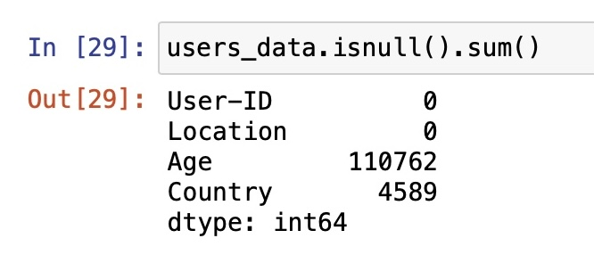
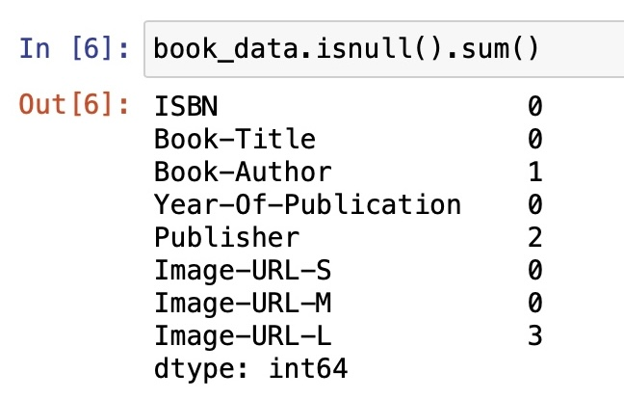
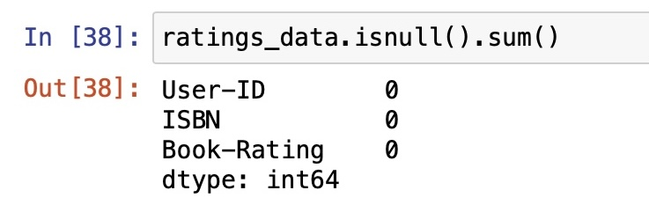
DATA PROCESSING

Slide 13

FINAL MERGED DATASETS

Slide 14
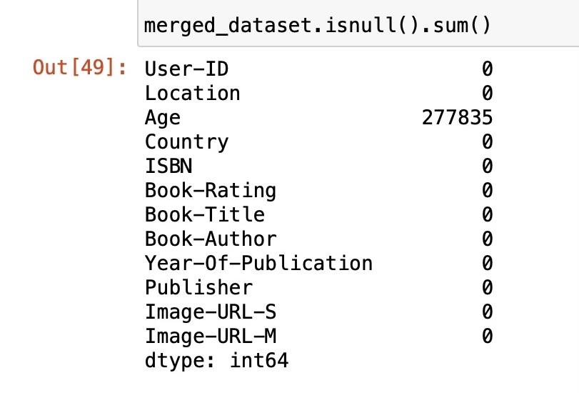
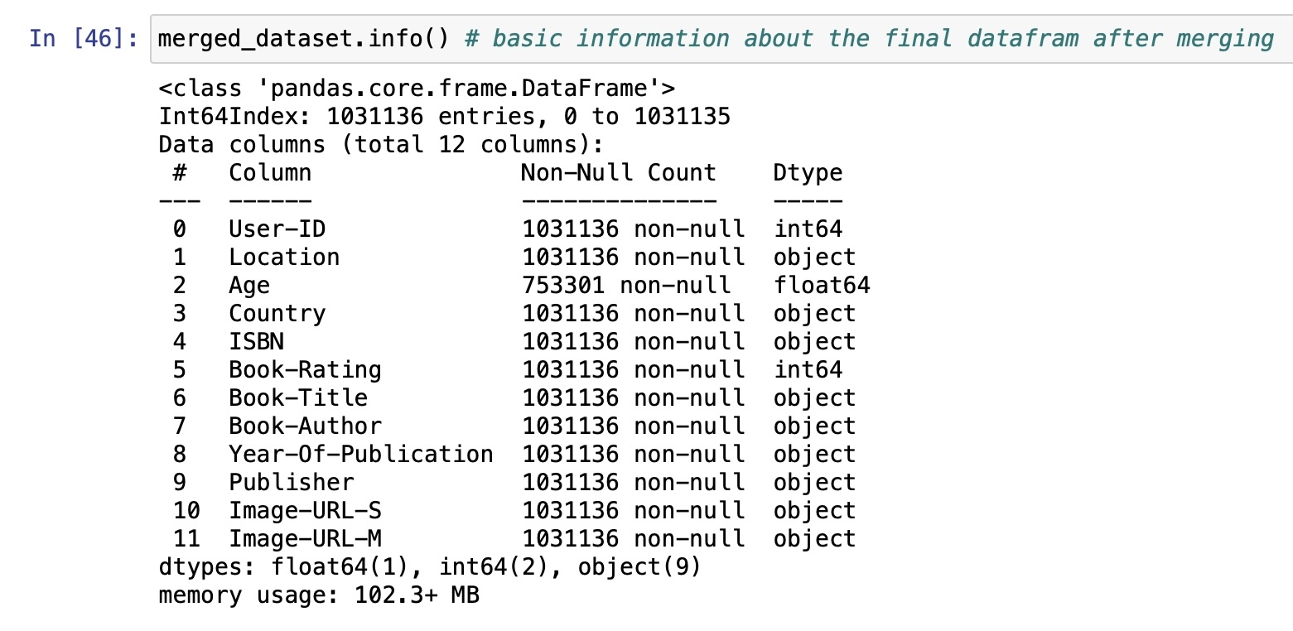
FINAL MERGED DATASETS

Slide 15

DATA ANALYSIS

Slide 16
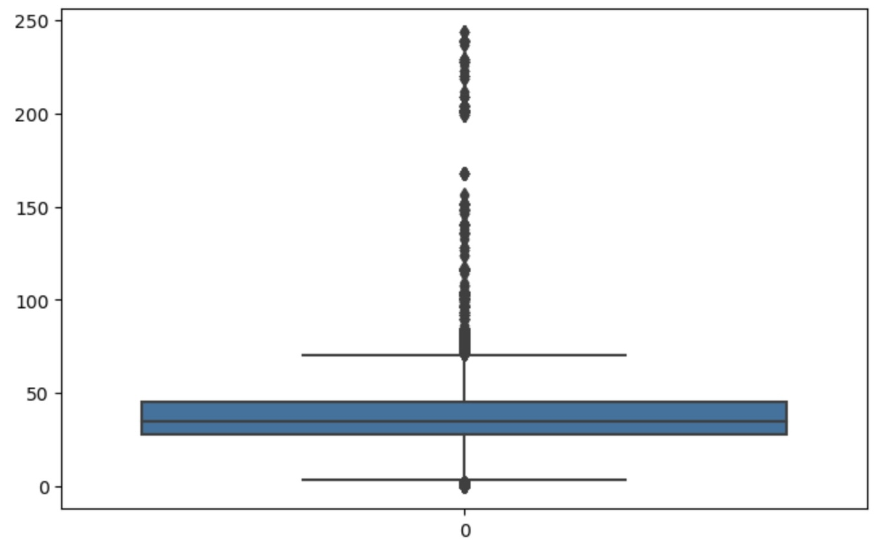
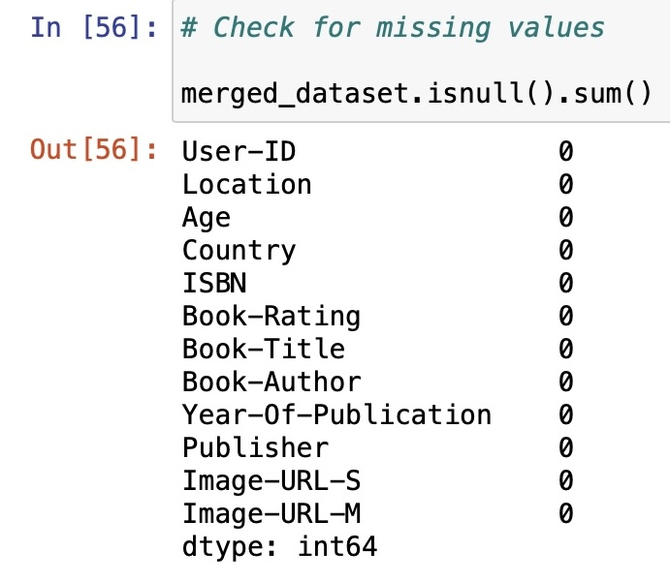
DATA ANALYSIS
It can be clearly seen that a lot of outliers are present in age column.
we have zero null value.

Slide 17
AGE AND BOOKS : ANALYSIS

Slide 18
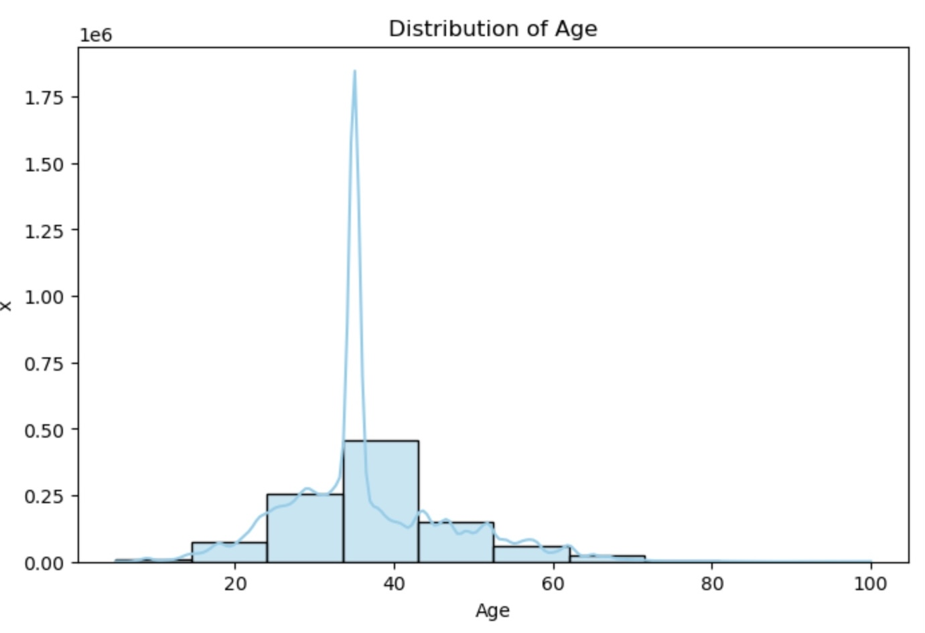
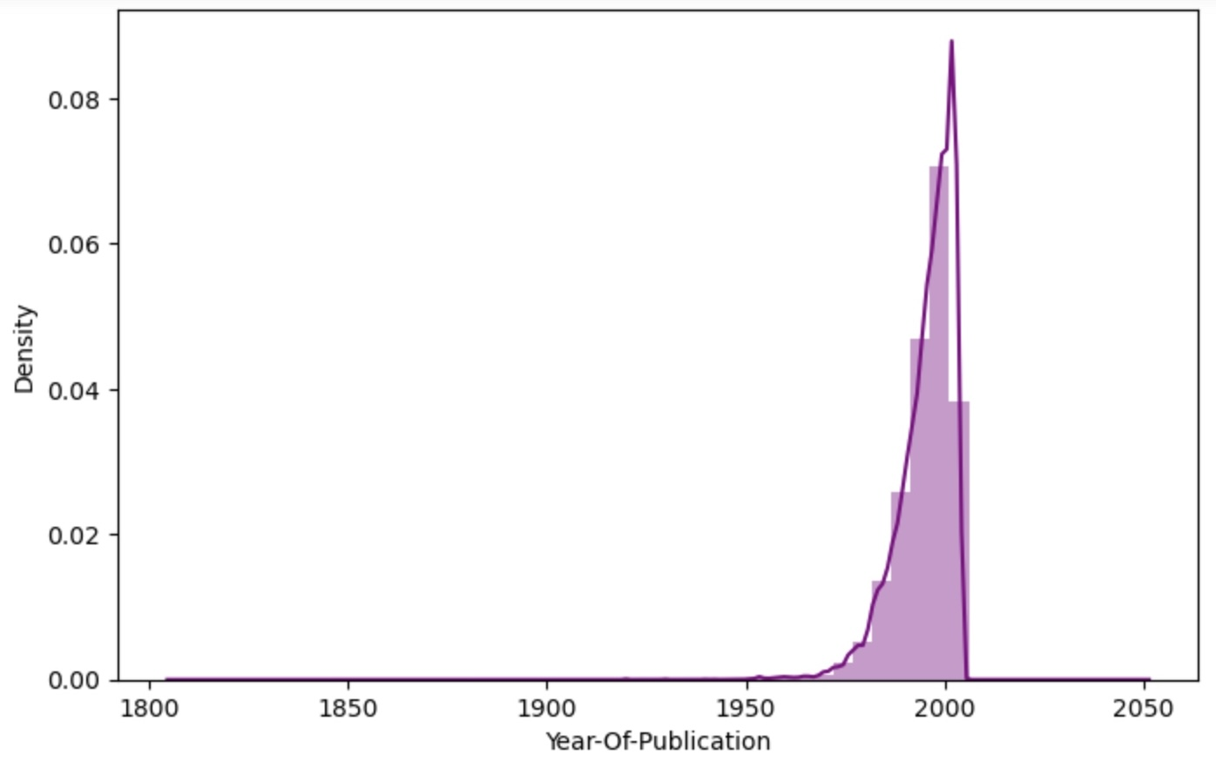
AGE AND BOOKS : ANALYSIS
It's observable that maximum number of users were of the age in between 20 to 60.
There was an exponential increase in book publication after the year 1950.

Slide 19
AUTHORS AND PUBLISHERS : ANALYSIS

Slide 20
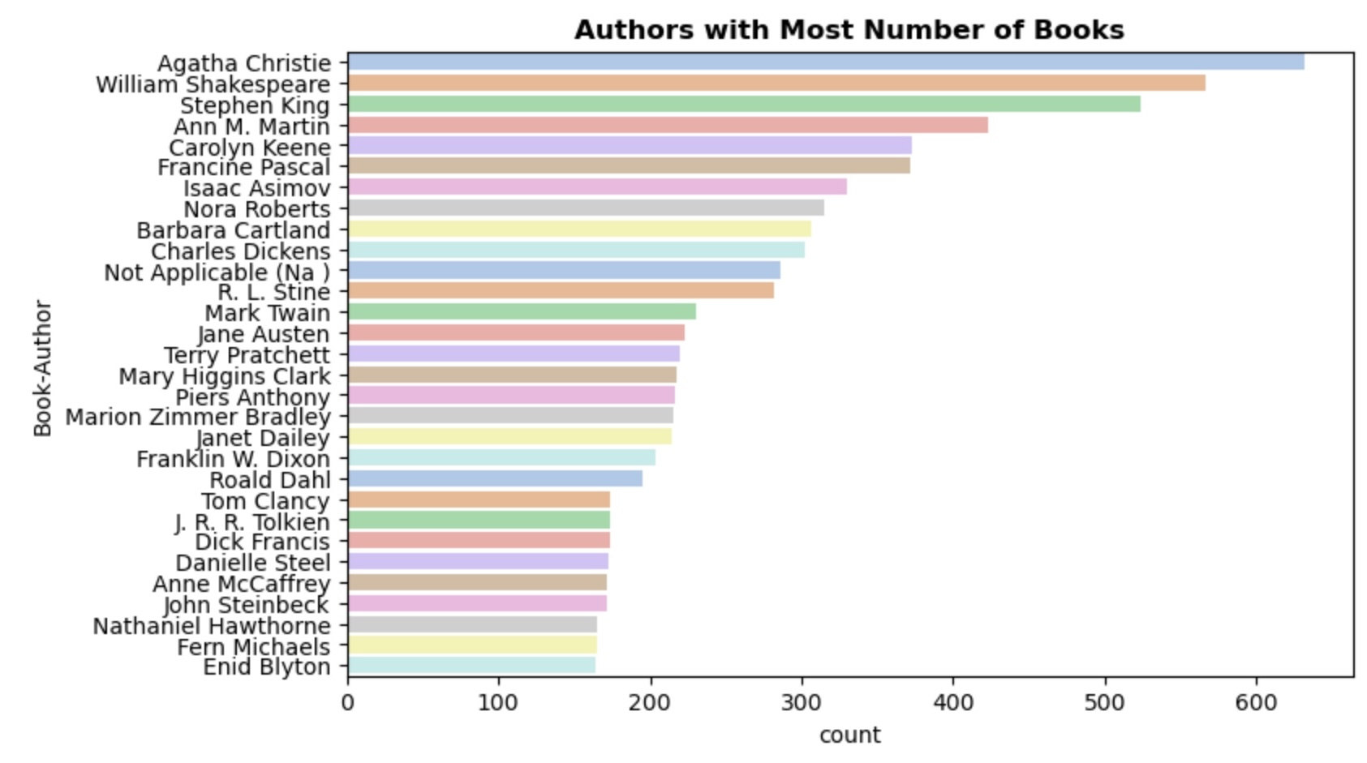
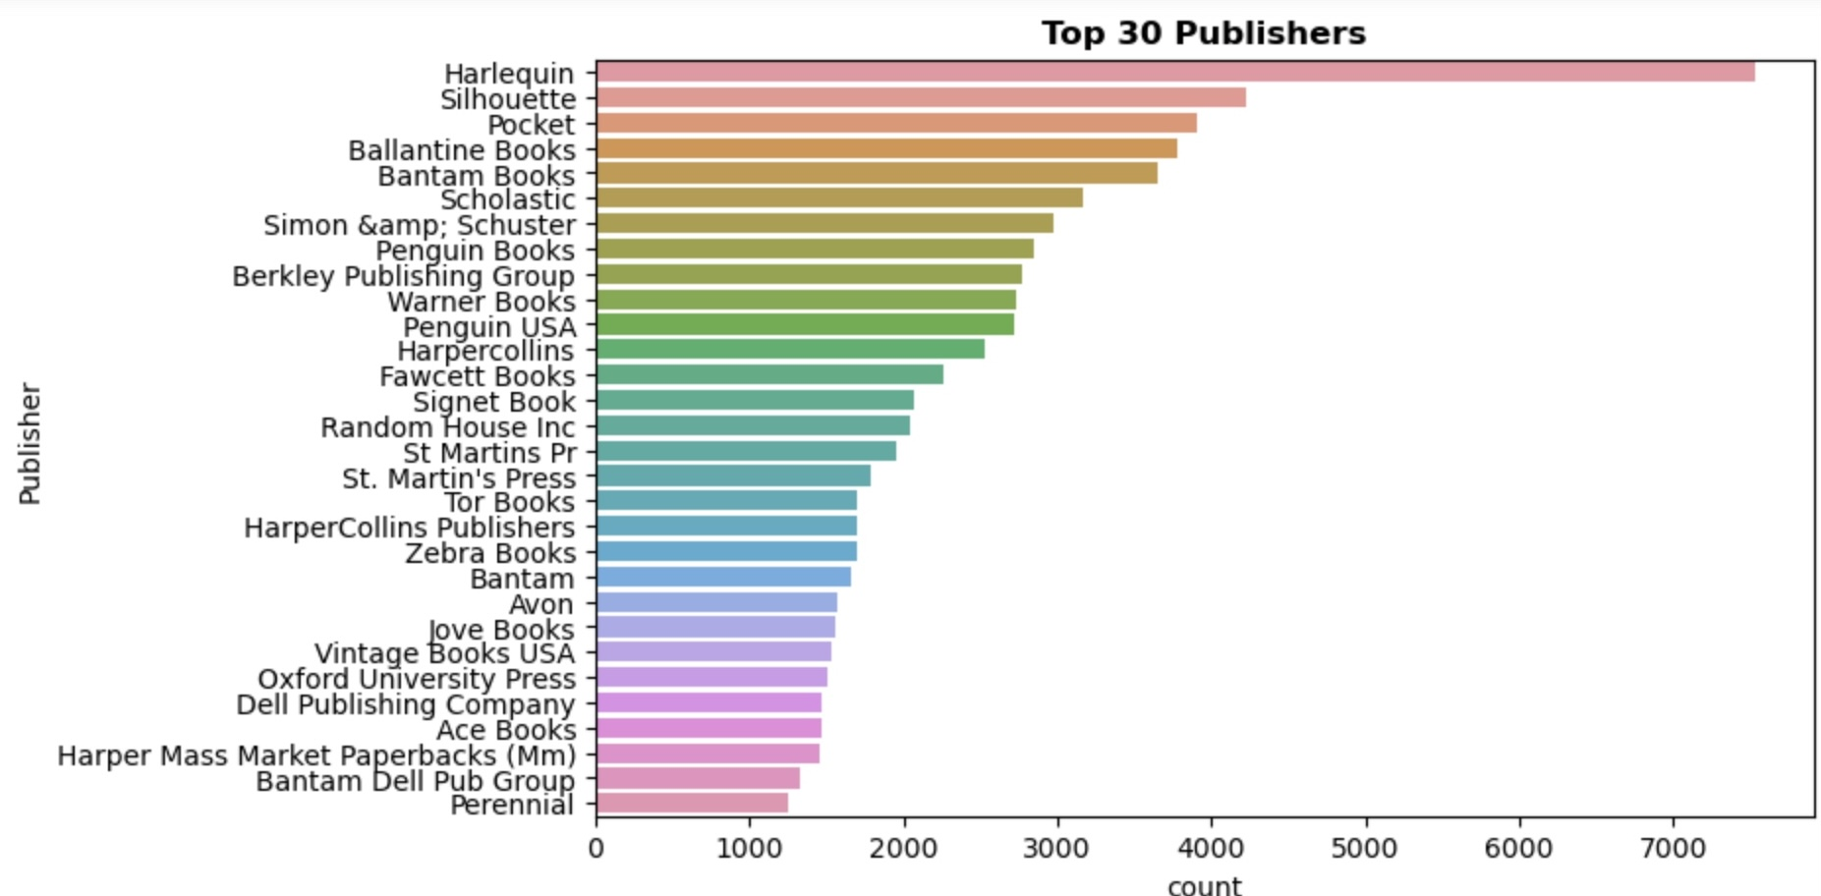
AUTHORS AND PUBLISHERS : ANALYSIS
Publisher with highest number of books published was Harlequin followed by Solhoutte and Pocket.

Slide 21
COUNTRY AND FAMOUS BOOK : ANALYSIS

Slide 22
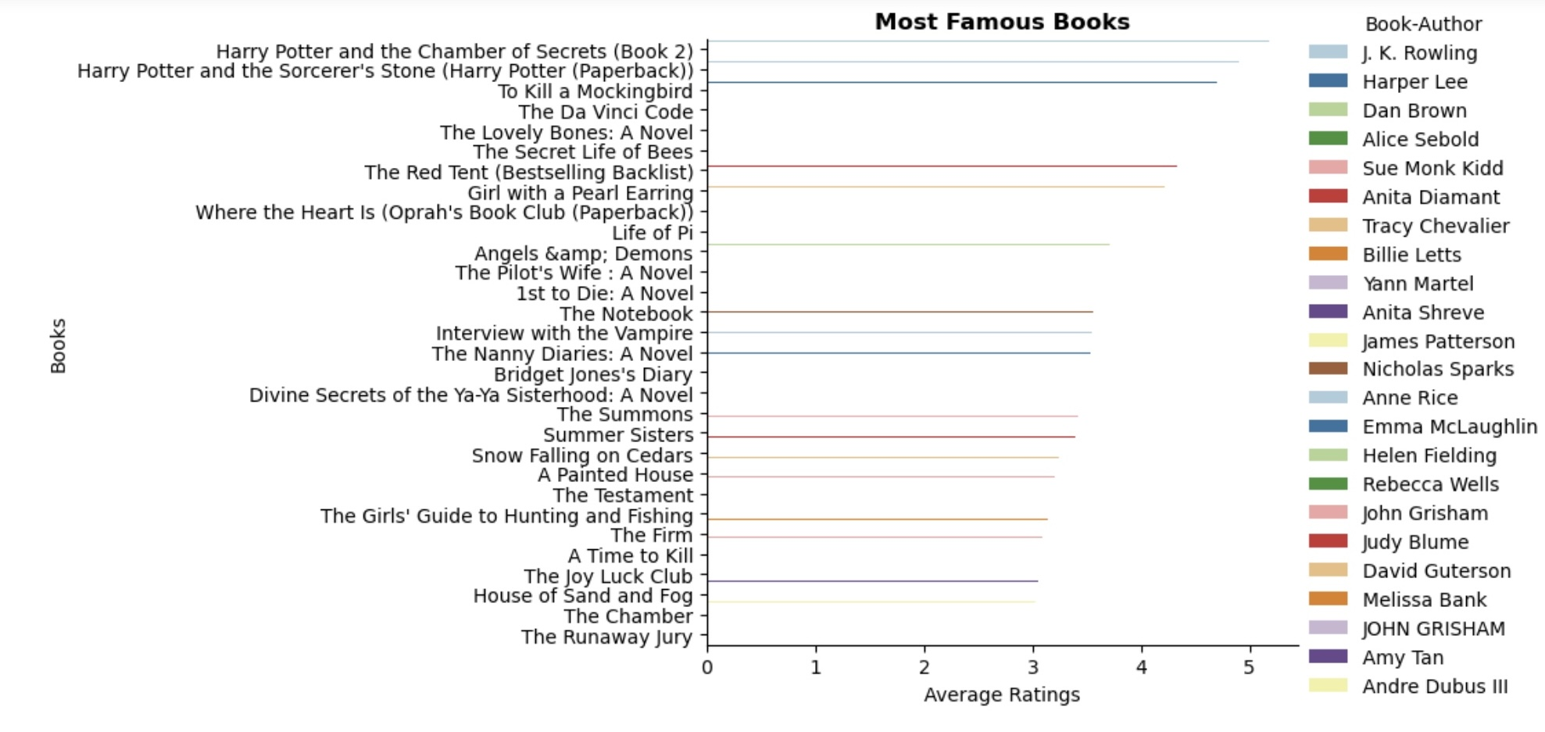
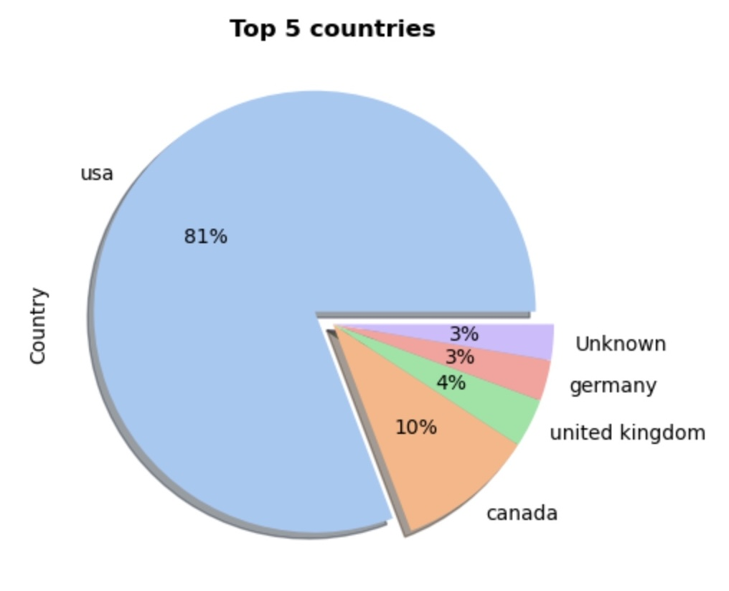
COUNTRY AND FAMOUS BOOK : ANALYSIS
Harry Potter authored by J K Rowling had got the best average ratings followed by To Kill a Mockingbird and The Da Vinci Code.

Slide 23
BOOK RATING AND COUNTRY : ANALYSIS

Slide 24
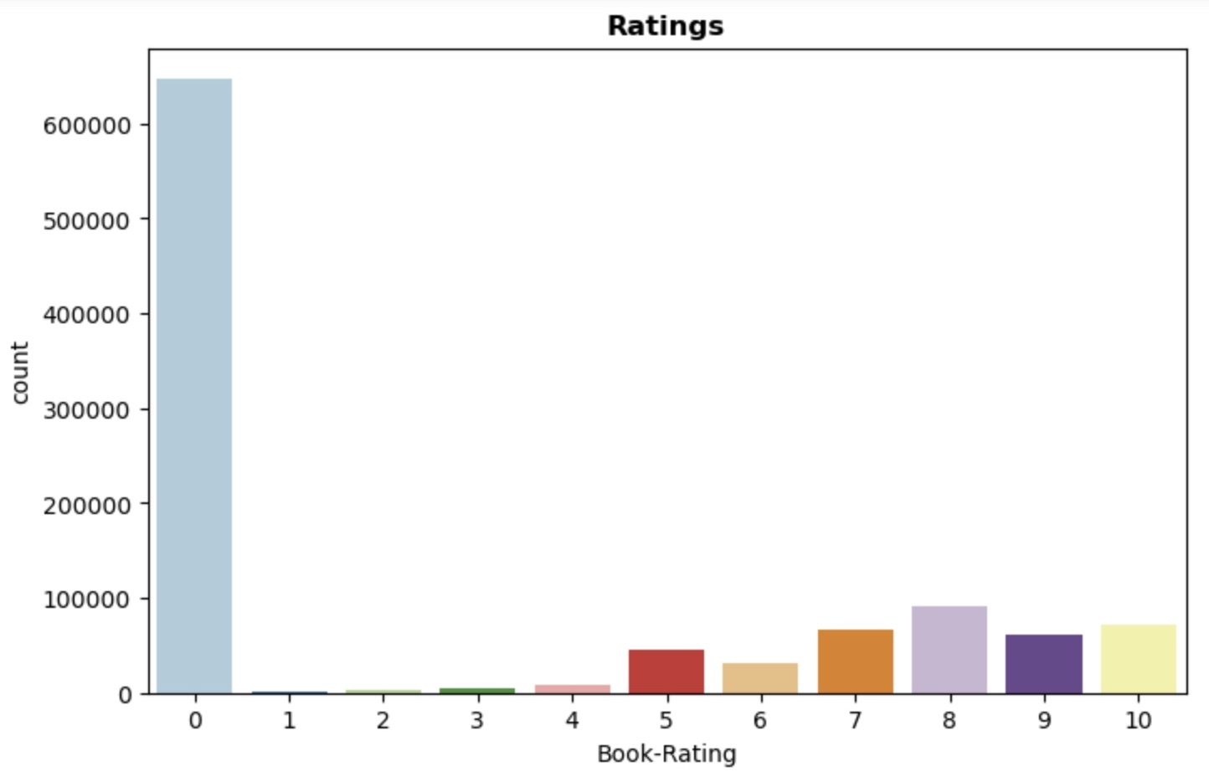
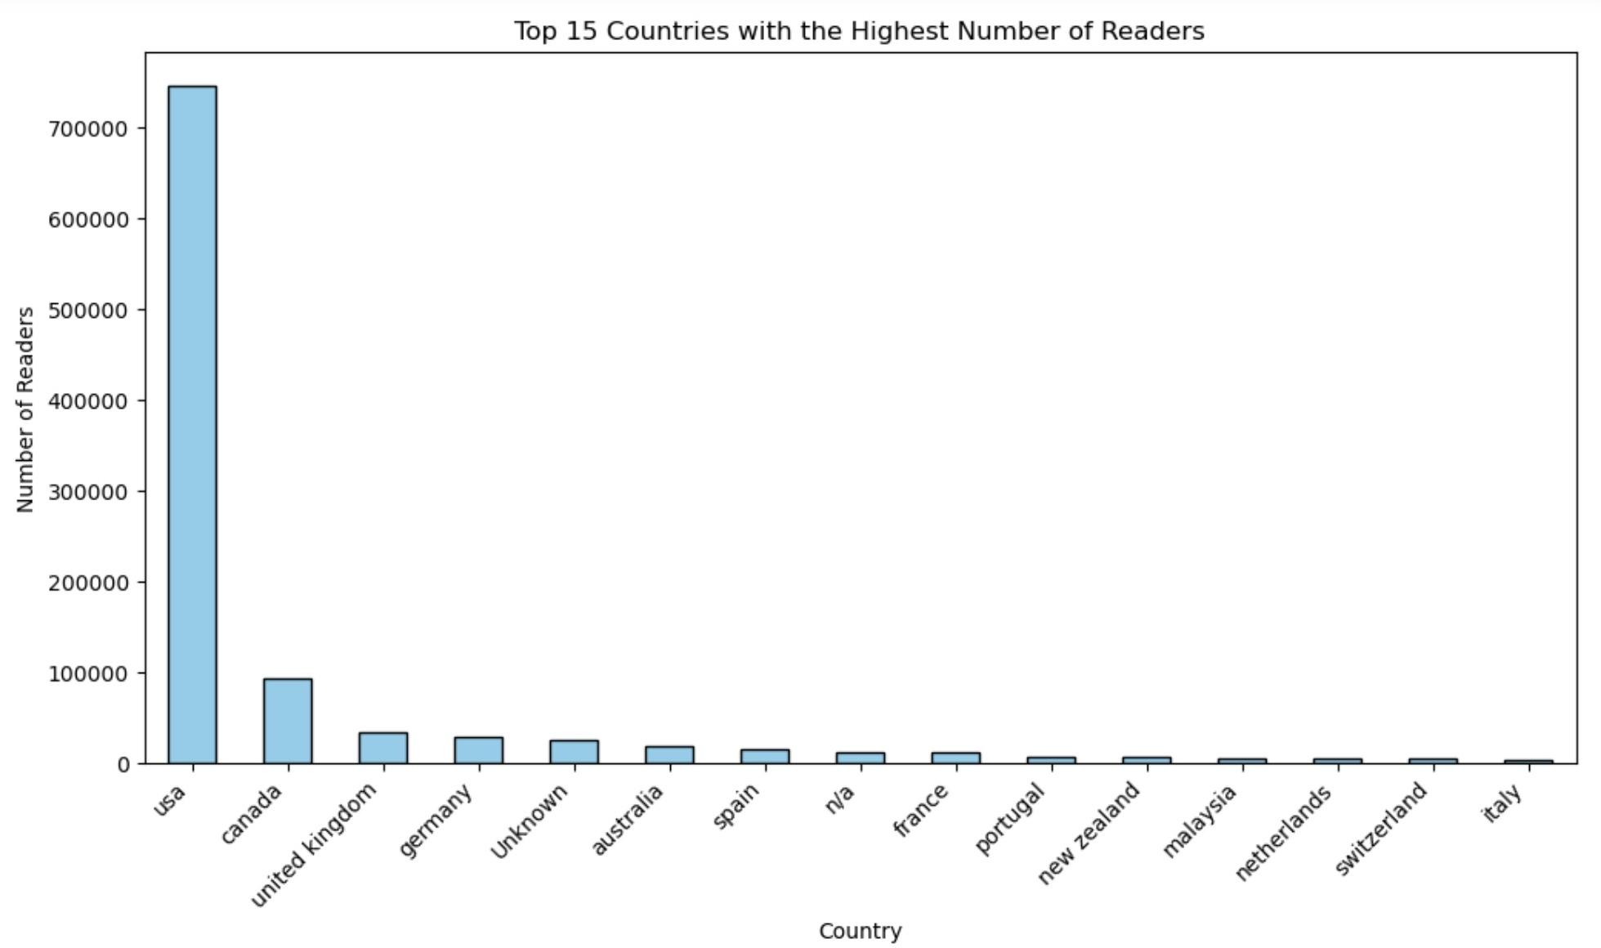
BOOK RATING AND COUNTRY : ANALYSIS
we can see that 8 is the most rated book if we exclude the rating o
Count plot of explicit ratings indicates that higher ratings are more common amongst users and rating 8 has been rated highest number of times.

Slide 25
COLLABORATIVE FILTERING MODELS

Slide 26
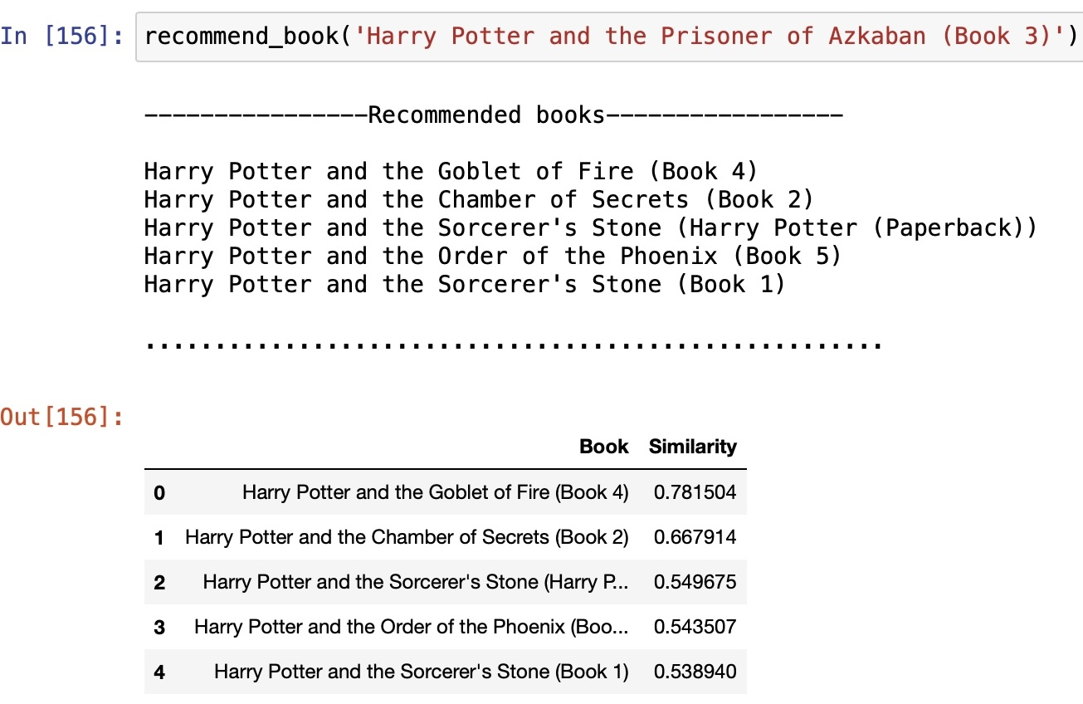
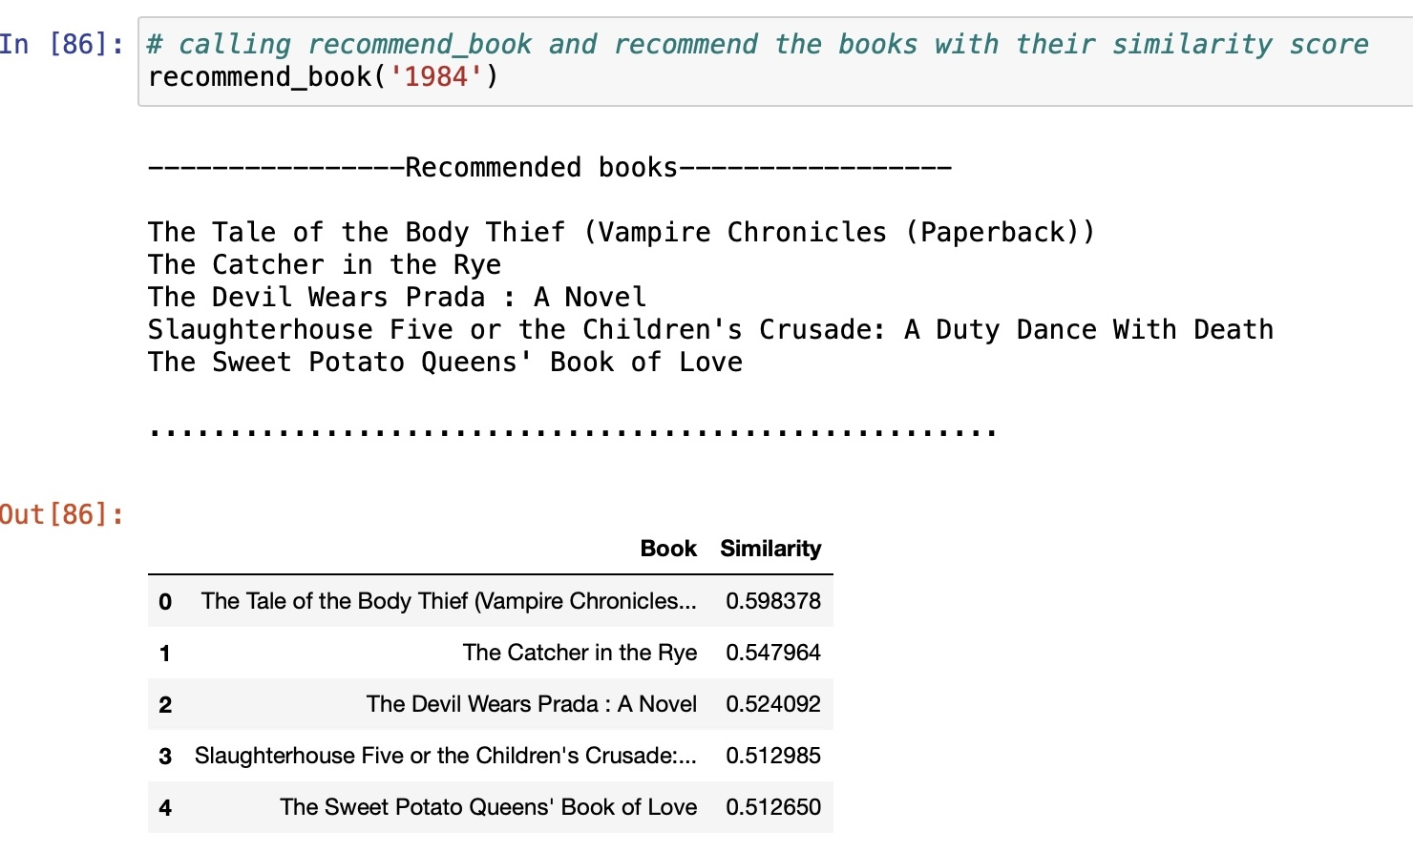
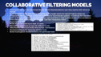
COLLABORATIVE FILTERING MODELS
Taking explicit rating means where book rating is not equal to zero.
user item matrix with values as ratings.
Create an object of cosine similarity.
Creating a function: recommend-book, Argument: book-name, Return type : data frame.
Creating a function : find_similarity_Score, Output : data frame, Argument similarity_score and pivot table

Slide 27
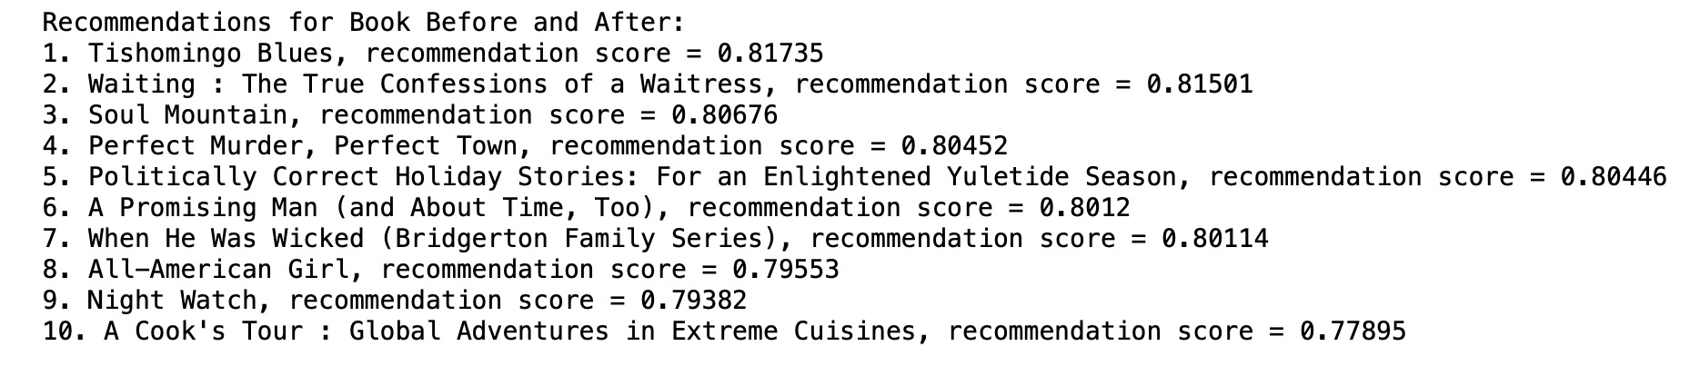
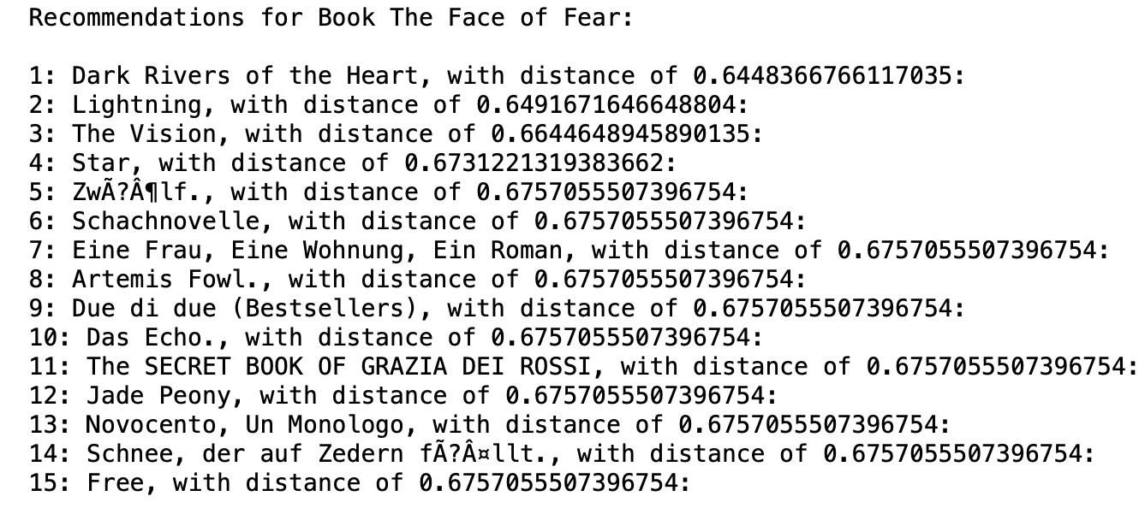
COLLABORATIVE FILTERING MODELS
Creating an object of csr matrix and Sparse Matrix Representations user item matrix with values as ratings.
Building a KNN model with Cosine Similarity as the target metric for calculating the distances.
Collaborative filtering methods Collaborative methods for recommender systems are methods that are based solely on the past interactions recorded between users and items in order to produce new recommendations. These interactions are stored in the so-called “user-item interactions matrix”.
Implementing KNN
Books which are rated by at least 10 users
Users which have rated at least 25 different books
Data frame of Users and Books with enough interactions
Recommendations for randomly selected book
Model building and recommendation for particular book

Slide 28
BEST RECOMMENDATION MODEL

Slide 29
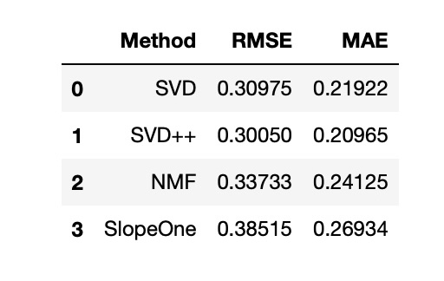
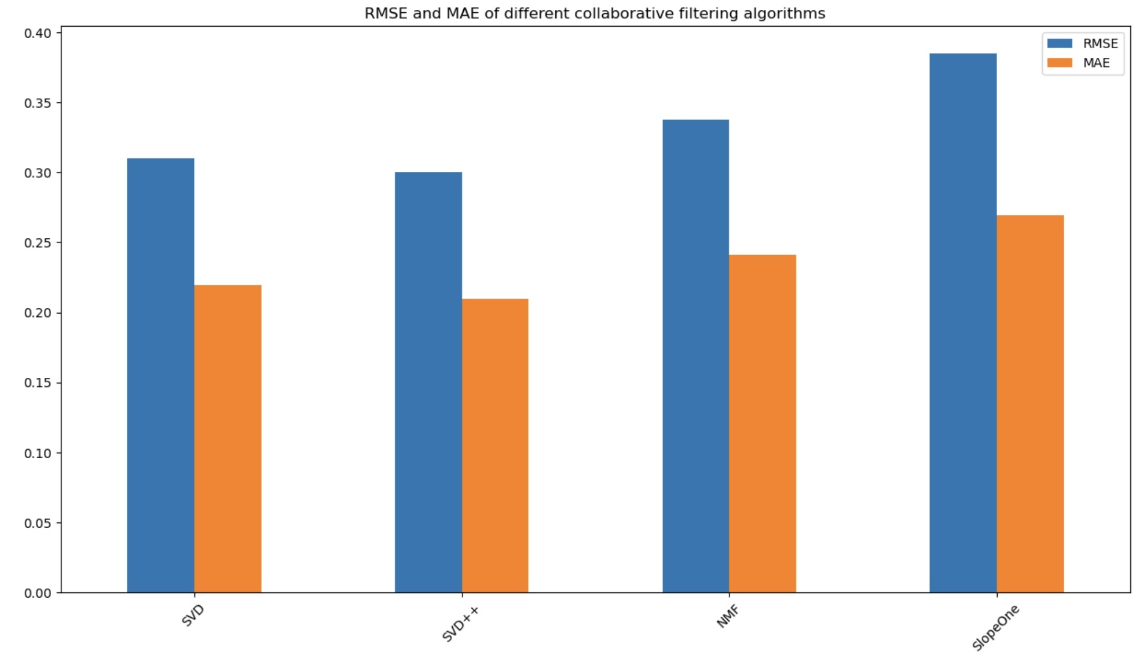
BEST RECOMMENDATION MODEL
Wild Animus is the best-selling book
Author Agatha Christie, William Shakespeare and Stephen King wrote most of the books
Harlequin publication published the most books
More than 50% readers are from USA
Book-Ratings are negatively distributed with median rating of 8.
Root mean squared error of model SVD is 0.31 and mean absolute error is 0.21
Root mean squared error of model NMF is 0.34 and mean absolute error is 0.24
Root mean squared error of model SlopeOne is 0.39 and mean absolute error is 0.27
SVD++ is the best recommendation model with root mean squared error of 0.30 and mean absolute error of 0.20

Slide 30
USER BASED RECOMMENDATION SYSYEM

Slide 31
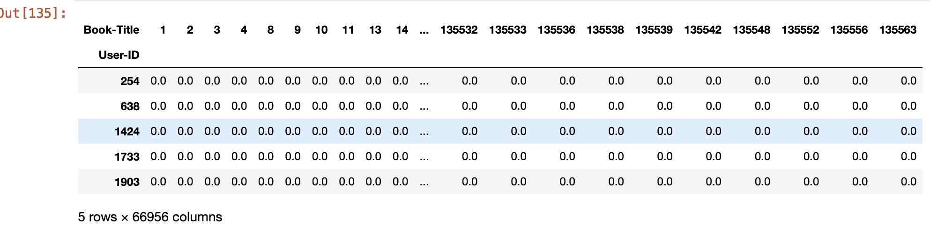
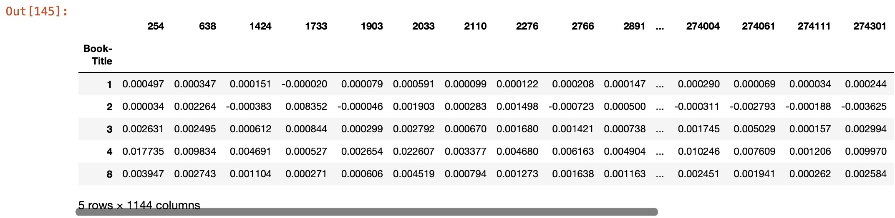
USER BASED RECOMMENDATION SYSYEM
Recommender systems have a problem known as user cold-start, in which it is hard to provide personalized recommendations for users with none or a very few number of consumed items, due to the lack of information to model their preferences. For this reason, we are keeping in the dataset only users with at least 100 interactions.
Creating an object of label encoder.
Creating a sparse pivot table with users in rows and items in columns.
Singular Value Decomposition
After the factorization, we try to to reconstruct the original matrix by multiplying its factors. The resulting matrix is not sparse any more. It was generated predictions for items the user have not yet interaction, which we will exploit for recommendations.
Converting the reconstructed matrix back to a Pandas dataframe
CFRecommender : This class is used to recommend book using SVD(Singular value decomposition)

Slide 32
USER BASED MODEL EVALUATION

Slide 33
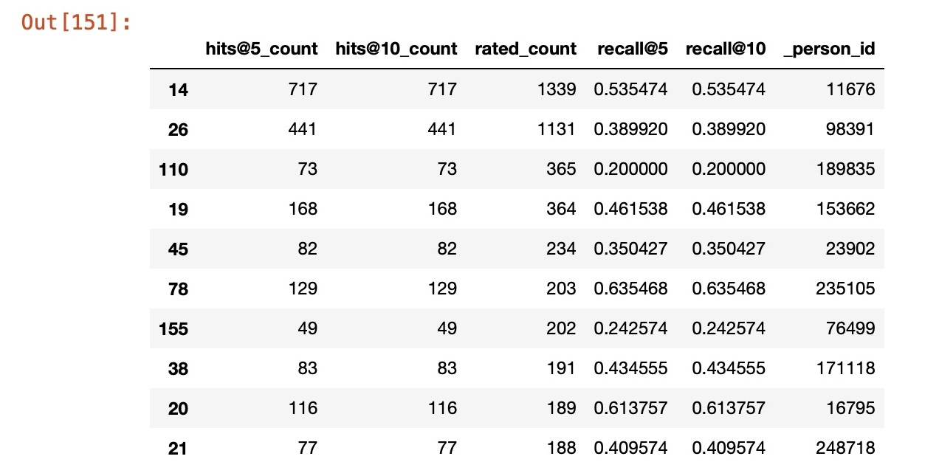

USER BASED MODEL EVALUATION
In Recommender Systems, there are a set metrics commonly used for evaluation. We choose to work with Top-N accuracy metrics, which evaluates the accuracy of the top recommendations provided to a user, comparing to the items the user has actually interacted in test set.
This evaluation method works as follows:
For each user
For each item the user has interacted in test set
Sample 100 other items the user has never interacted.
Ask the recommender model to produce a ranked list of recommended items, from a set composed of one interacted item and the 100 non-interacted items
Compute the Top-N accuracy metrics for this user and interacted item from the recommendations ranked list
Aggregate the global Top-N accuracy metrics

Slide 34
USER BASED MODEL EVALUATION
CONCLUSION
First We got insights that the majority of users did not rate the books. Also majority of the books were rated 8/10.
The majority of the readers were in the age group of 20-45.
We saw an exponential increase in the publication of books after the year 1950.
Agatha christie, and William Shakespeare wrote the maximum no. of books.
And the maximum books were from the publication house Harlequin and Silhouette.
Harry Potter authored by J K Rowling had got the best average ratings followed by To Kill a Mockingbird and The Da Vinci Code.
Finally, we evaluated our models using recall at @5 and recall @10 where we got the value to be 81%.

Slide 35
DEPLOYMENT

Slide 36
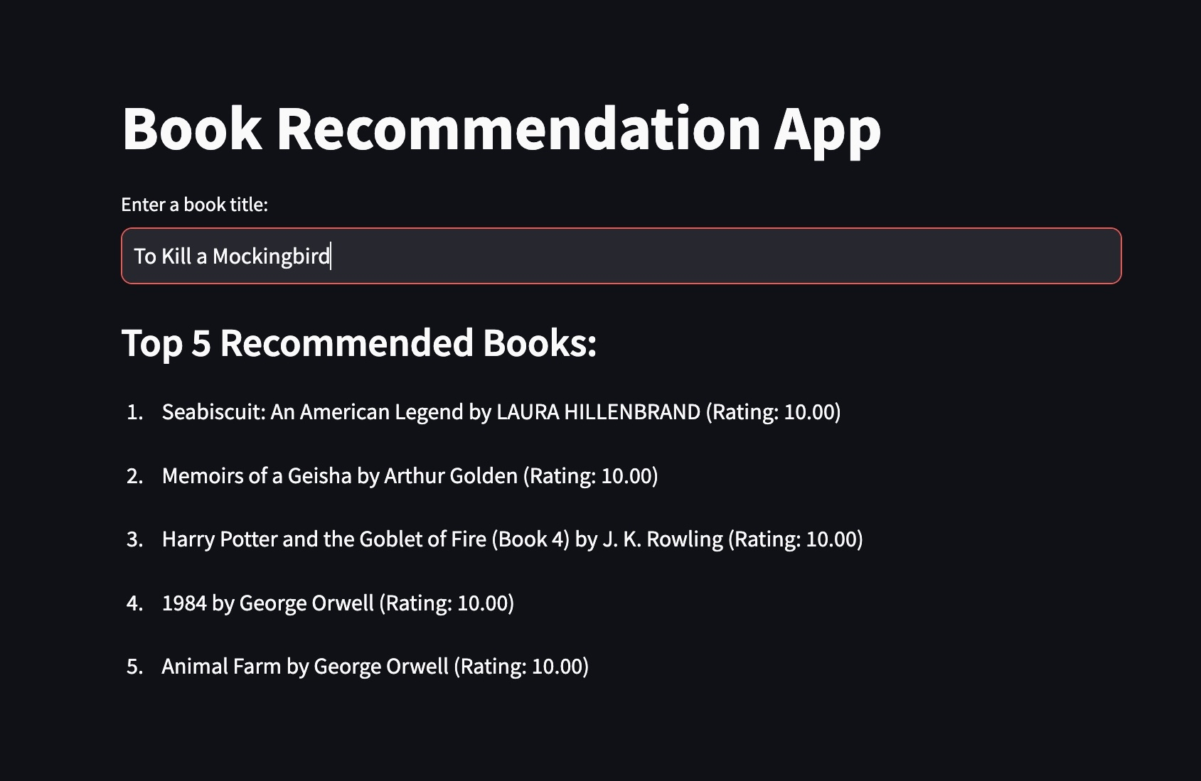
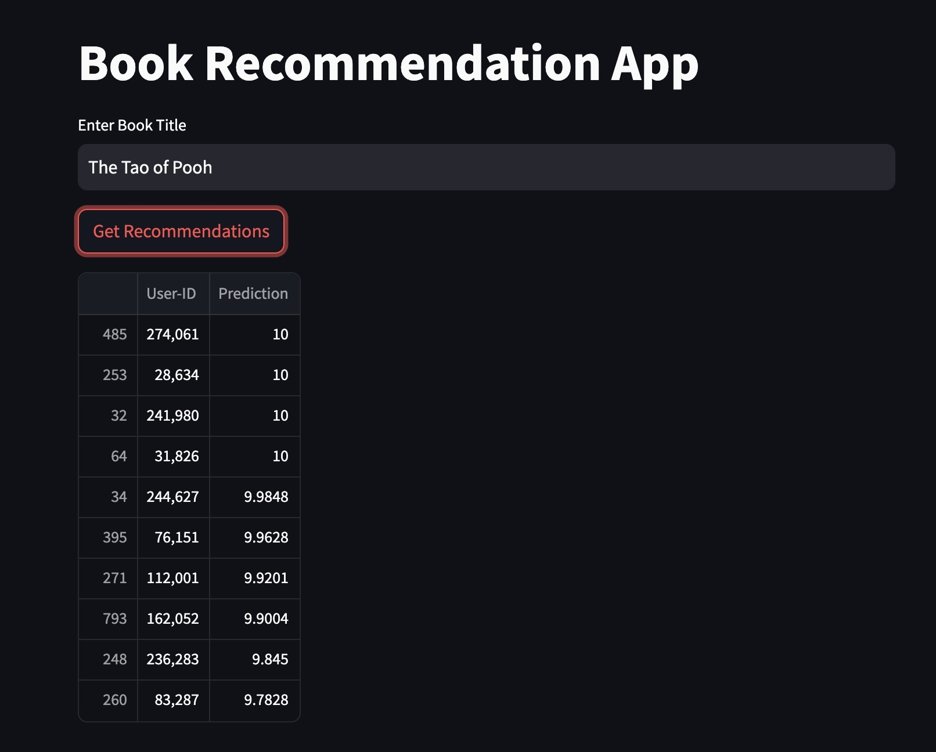
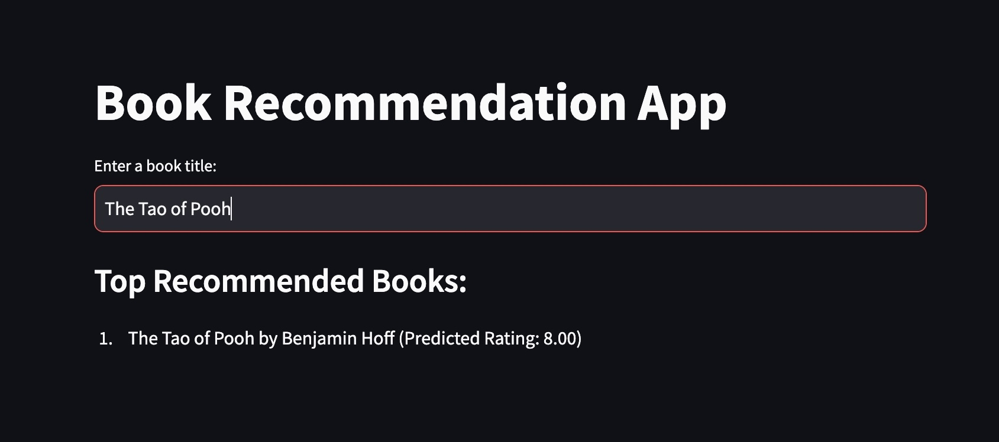
DEPLOYMENT
https://github.com/Praveen-collab-analyst/PERSONAL_BOOK_RECOMMENDATION_SYSTEM

Slide 37

THANK YOU

Slide 38
THANK YOU

